Slide 1
How do I get to the…?
Giving directions

Slide 2
Turn left!
Turn right!
Go straight on!

Slide 3
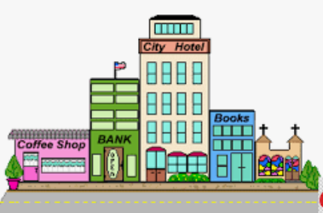
1. Where is the coffee shop?
2. Where is the city hotel?
3. What is between the coffee shop and the city hotel?

Slide 4
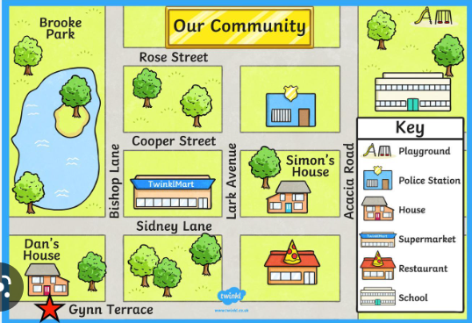
How do I get to the…?

